Slide 1
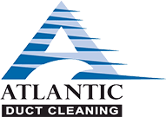
Atlantic Duct Cleaning
Air Duct Cleaning Guide
AtlanticDuctCleaning.com
703-435-4485

Slide 2
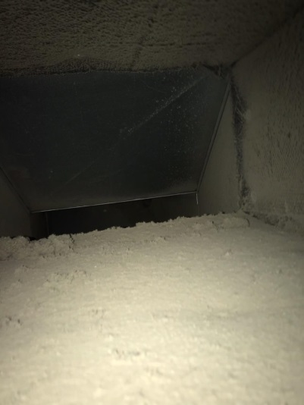
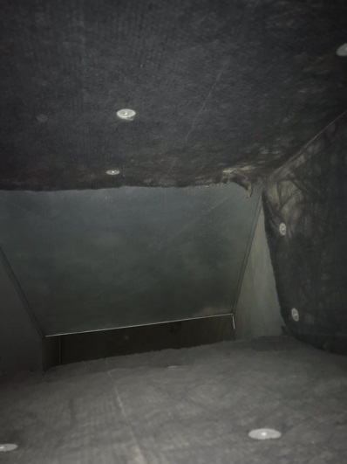
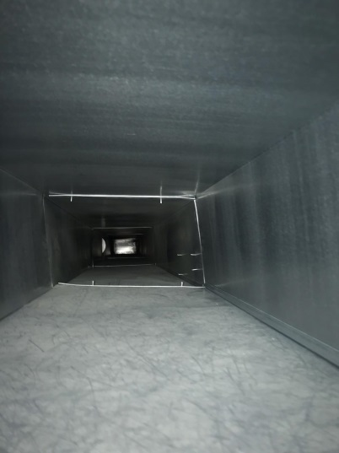
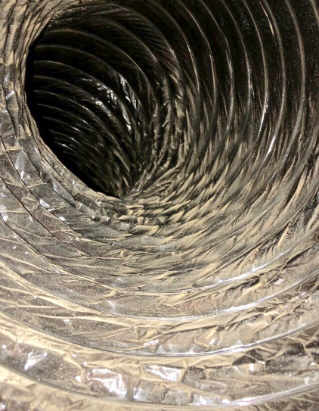
What Do We Clean?
Both the Supply and Return lines, from the register all the way back to the unit
We clean in accordance to NADCA (North American Duct Cleaning Association) standards
AtlanticDuctCleaning.com
703-435-4485

Slide 3
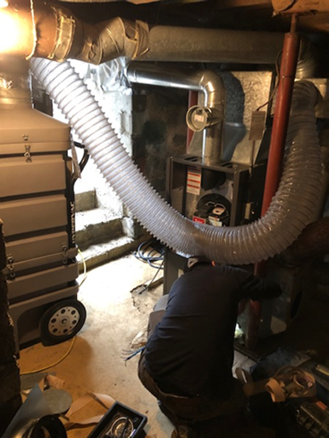
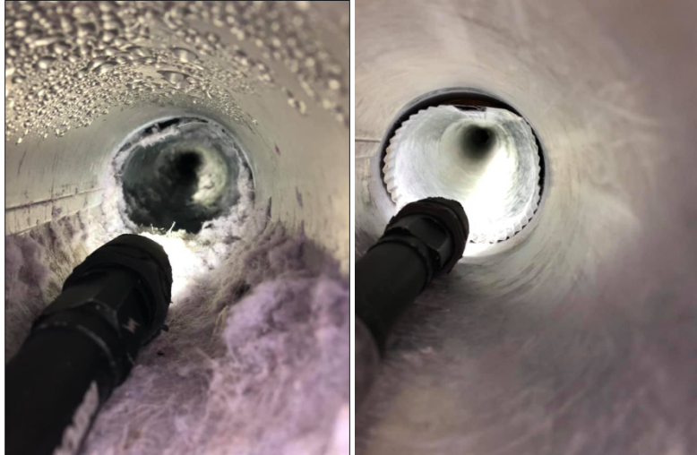
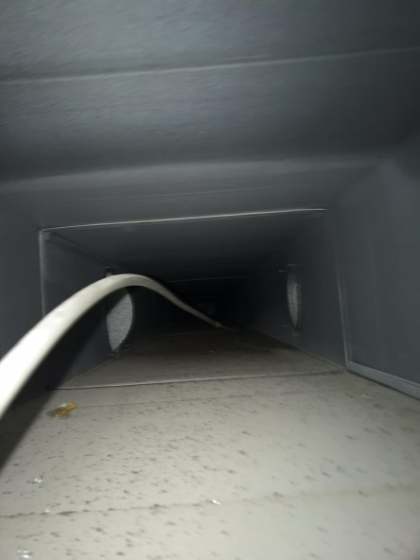
What Equipment Do We Use?
For removal of debris we use a Hyper VAC
We use compressed air to go line by line and knock debris loose pushing it into the Hyper VAC
AtlanticDuctCleaning.com
703-435-4485

Slide 4
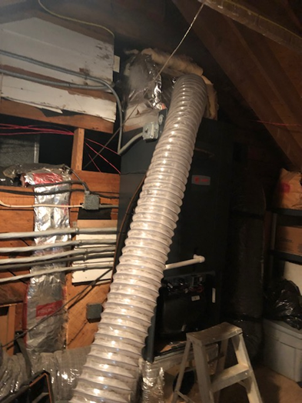
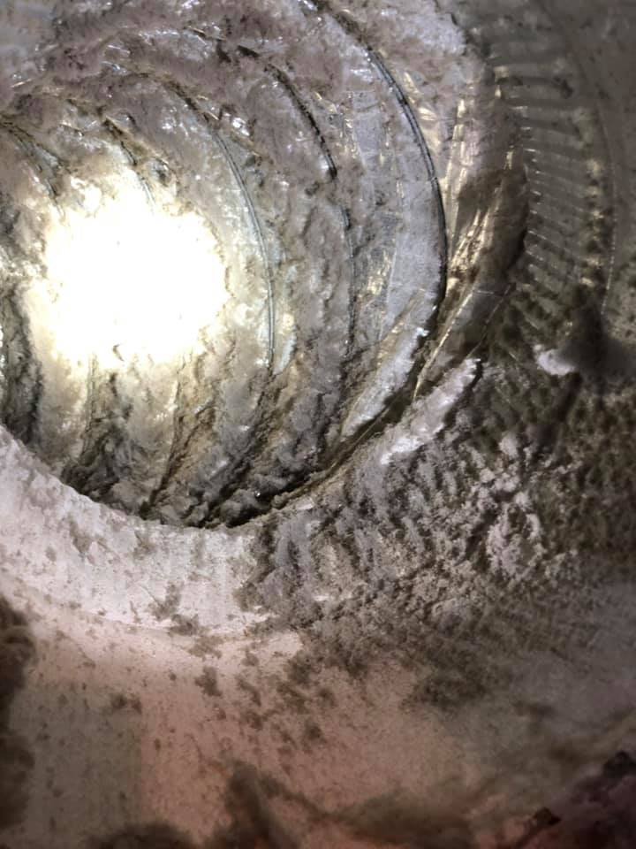
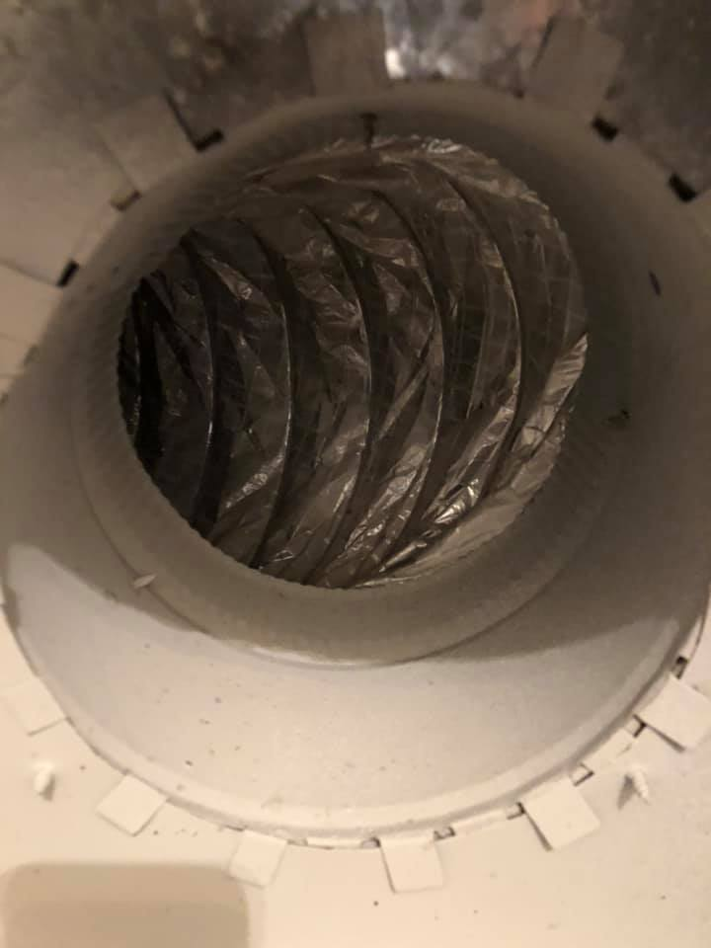
How Do We Clean?
We cut a 10 inch access hole on both trunk lines that we seal back, with sheet metal, upon completion. As the Vacuum is creating pressure, we go to each register and dislodge debris pushing it through the duct work and into the HYPER VAC
AtlanticDuctCleaning.com
703-435-4485

Slide 5
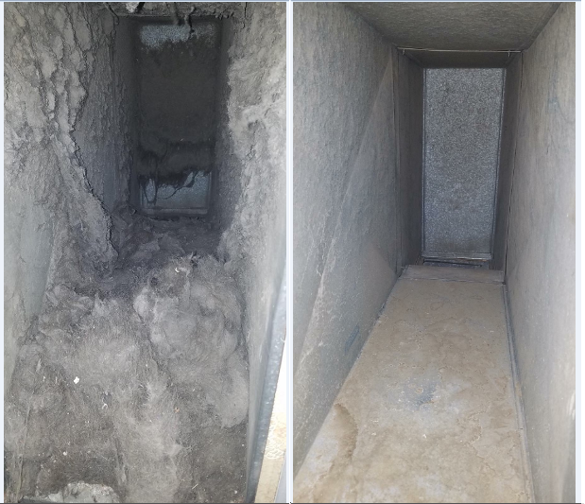
FAQ’S
Do we use chemicals?
No, we only use air to push and pull debris through the duct work
Can I be in the house when this is being completed?
Yes
How long does it take?
2-3 hours per system
How often should you get your ducts cleaned?
5-8 years
AtlanticDuctCleaning.com
703-435-4485

Slide 6
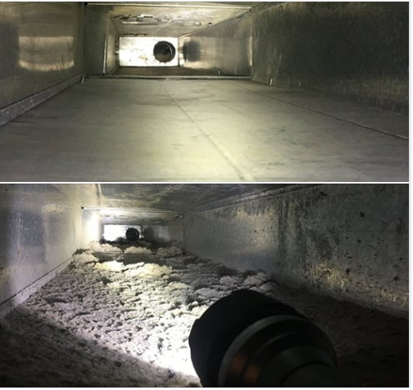
Our Resume
In business since 1995
Completed over 130,000 air duct cleanings
Largest air duct cleaning company in the Country
Over 100 “5 Star” Google reviews
We do not sell anything.
What you schedule is what we complete
AtlanticDuctCleaning.com
703-435-4485

